Slide 1
Shark attacks over the past 100 years

Slide 2
Data
Source: Kaggle
https://www.kaggle.com/datasets/mysarahmadbhat/shark-attacks
6000 rows

Slide 3

Process
Hidden unneeded columns:
Date, Location, Name, Time, Species, Investigator
Year column:
Deleted rows where the years were earlier than 1917
Type column:
Deleted invalid values (e.g. boat, sea disaster)
Left only correct values (provoked/ unprovoked)
Country, Area, Injury, Activity columns:
no changes

Slide 4
Process
Gender column:
Deleted invalid values (e.g. N, lli, dot)
Left correct values (F, M)
Age column:
Deleted non-numerical and difficult to use values, e.g.: 20s, teens, 11&12, young, elderly, mid-30s.
Deleted invalid values, e.g. F, M.
Left correct values (2,56)
Fatal/ non-fatal column:
Deleted invalid values (2017, Unknown, F)
Left correct values (Y, N)

Slide 5
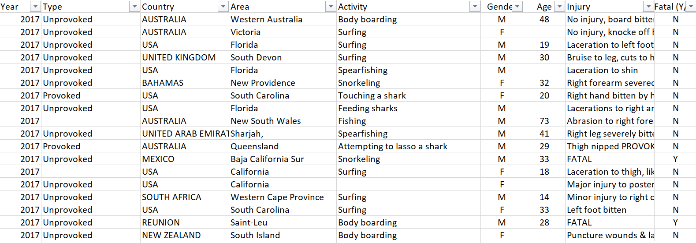

Slide 6
Questions
Is there any trend in shark attacks over the past 100 years?
Which countries report the most shark attacks?
Who was attacked more often by sharks - men or women?
Is there any difference in the number of provoked and unprovoked attacks?
What is the ratio of fatal and non-fatal outcomes?

Slide 7
Insights
A spike in attacks in the beginning of 1960s
Gradual growth since 1980 till 2017
Top 3 countries: USA, Australia, South Africa
Men attacked more often: 4049 against 551

Slide 8
Insights
The majority of attacks were unprovoked: 3763 against 509
Almost 4 times less fatal attacks than non-fatal: 1065 against 3984
Percentage of fatal attacks:
USA – 9%
South Africa - 20%
Australia – 22%

